Slide 1

Object Oriented Programming
Creational Design Patterns: Object Pool
IT560
Sourish Dasgupta
Assistant Professor, DA-IICT, Gandhinagar
https://daiict.ac.in/faculty/sourish-dasgupta

Slide 2
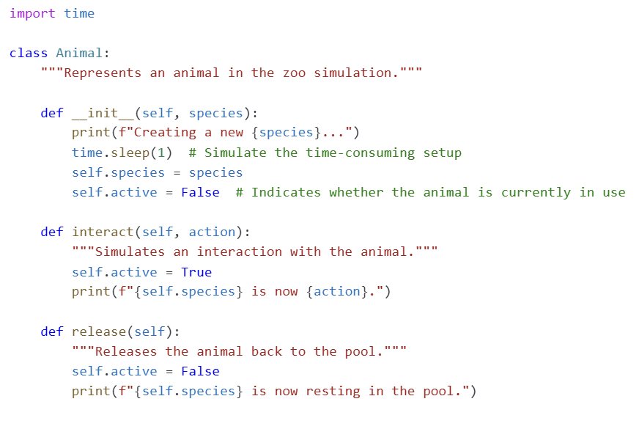
Object Pool Design Pattern : Reusing without destroying
1️⃣ Initialize a pool with a fixed number of pre-created objects.
2️⃣ Acquire an object from the pool when needed.
3️⃣ Use the object as required.
4️⃣ Release the object back into the pool for reuse.
IT560: Creational Design Patterns: Object Pool
Sourish Dasgupta

Slide 3
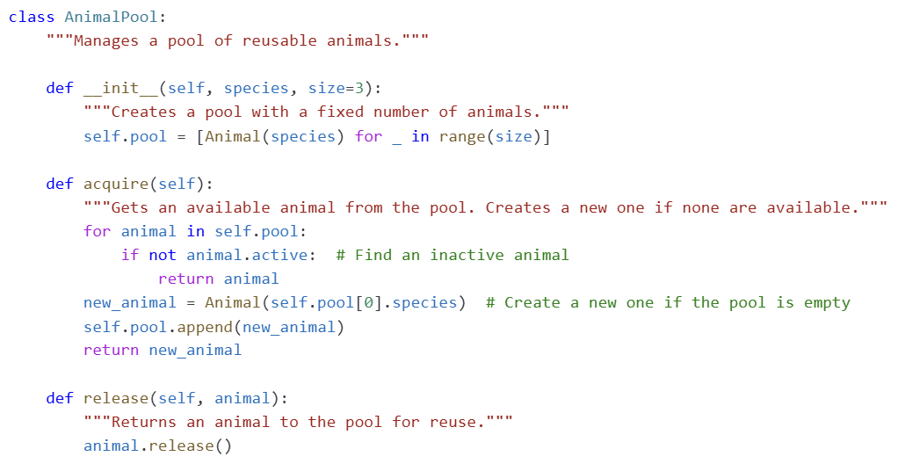
Object Pool Design Pattern : Reusing without destroying
Trivia: Python’s way of getting
away w/o a variable
IT560: Creational Design Patterns: Object Pool
Sourish Dasgupta

Slide 4
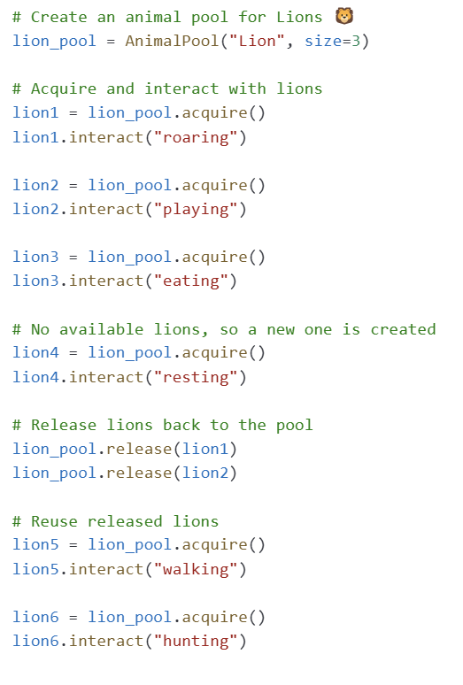
Object Pool Design Pattern : Reusing without destroying
Every interaction is via the pool
IT560: Creational Design Patterns: Object Pool
Sourish Dasgupta

Slide 5
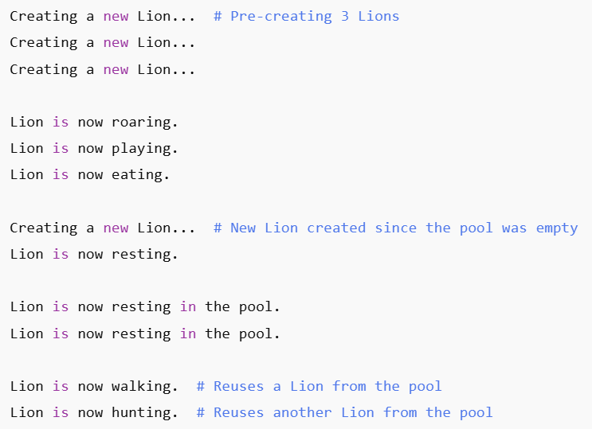
Object Pool Design Pattern : Reusing without destroying
IT560: Creational Design Patterns: Object Pool
Sourish Dasgupta

Slide 6
Object Pool Design Pattern : Takeaways
Advantage | Explanation
Performance Boost | Avoids repeated object creation and destruction.
Efficient Memory Usage | Keeps a fixed number of objects active, reducing memory bloat.
Ideal for Repeated Interactions | Perfect when the same objects are used frequently.
IT560: Creational Design Patterns: Object Pool
Sourish Dasgupta

Slide 7
When does the pool get muddy?
IT560: Creational Design Patterns: Object Pool
Sourish Dasgupta

Slide 8
Object Pool Design Pattern : Takeaways
Scenario | Why Object Pool is NOT Ideal?
Animals require unique attributes | If every animal must have a distinct identity, pooling might cause state issues.
Short-lived animals | If animals are rarely reused, pooling adds unnecessary complexity.
Memory is not a concern | If system resources are sufficient, object pooling may be overkill.
IT560: Creational Design Patterns: Object Pool
Sourish Dasgupta

Slide 9
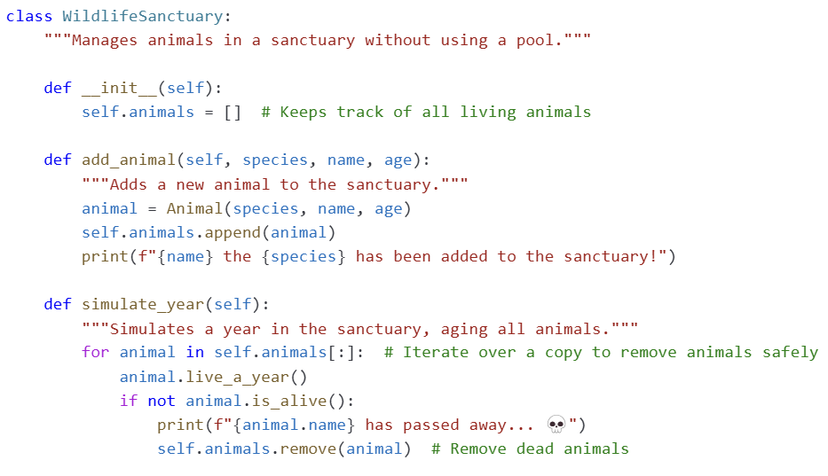
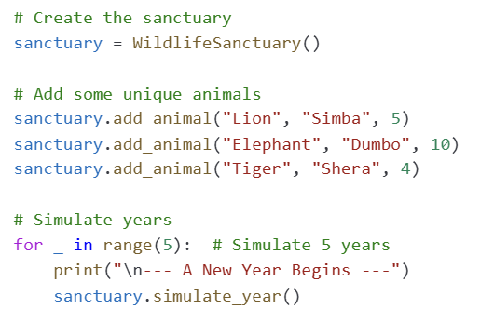
Dynamic Object Mgmt.: Much better off without a pool!
🚀 Objects (animals) are created dynamically when needed.
🚀 Each object has a unique state (name, age, health).
🚀 Objects (animals) are removed (die) when they are no longer valid.
🚀 The number of objects is not fixed and changes over time.
IT560: Creational Design Patterns: Object Pool
Sourish Dasgupta

Slide 10
Object Pool Design Pattern : Takeaways
Issue | Why Object Pool Fails?
Animals are not reusable | Once an animal dies, it cannot be returned to the pool.
Each animal is unique | Different names, ages, and health conditions mean animals cannot be simply reset and reused.
State retention is required | Object pools usually reset object states, but these animals have progressive aging and health decline.
Variable object count | Object pools assume a fixed number of objects, but here, animals are born and die dynamically.
IT560: Creational Design Patterns: Object Pool
Sourish Dasgupta

